Slide 1
Key information for UK companies importing goods from the EU after 1st January 2021

Slide 2
ON THE WEBINAR TODAY
Tony Shally
MD and Head of all things Brexit
Robert Pryce
Clearlight Customs Ltd
Geoff Yates
Commercial Manager

Slide 3
TOPICS TO COVER
Are your EU suppliers ready?
3 different ways to make import
declarations from 1.1.2021
- Full declaration
- SFD followed by Supplementary declaration
- EIDR / CFSP
Importing goods under DDP
UK Global tariff
Duty Deferment accounts
Postponed VAT Accounting
Alternative means of transport to import goods into UK for EU
Direct Representative Authorisation form
Return packaging to EU
Commercial sample

Slide 4
WHERE ARE WE AT NOW?
31 Working Days

Slide 5
EXPORT
Every import starts with an export
IMPORT
Are your EU suppliers ready?
No staged approach – full customs controls apply immediately.
Do they have a customs agent to make their export declarations?
Have you agreed with them the INCO term to be used?
If they are using DDP, have they got a UK EORI and VAT number and a UK customs agent to make UK import clearances?
Do they have your EORI number?
Is there a CPC on their invoice to you?
Are their hauliers / forwarding agents capable of navigating the new EU port exit requirements?
If sending multiple commodity codes to you, have they listed them separately on their invoice showing individual gross / net weight, number of pieces and value?

Slide 6
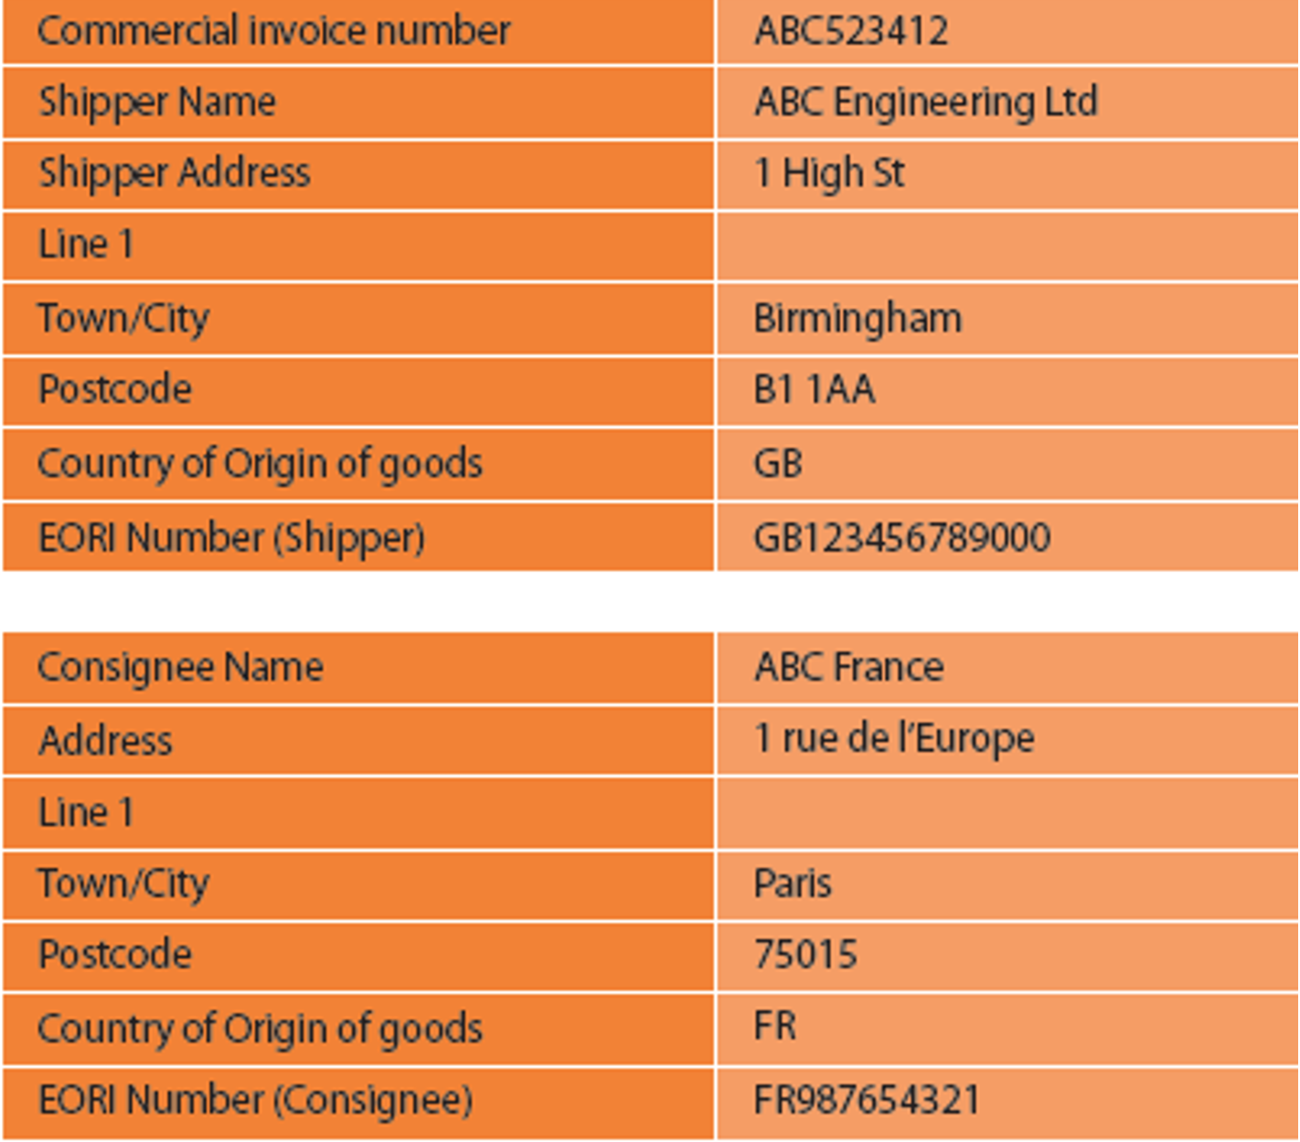
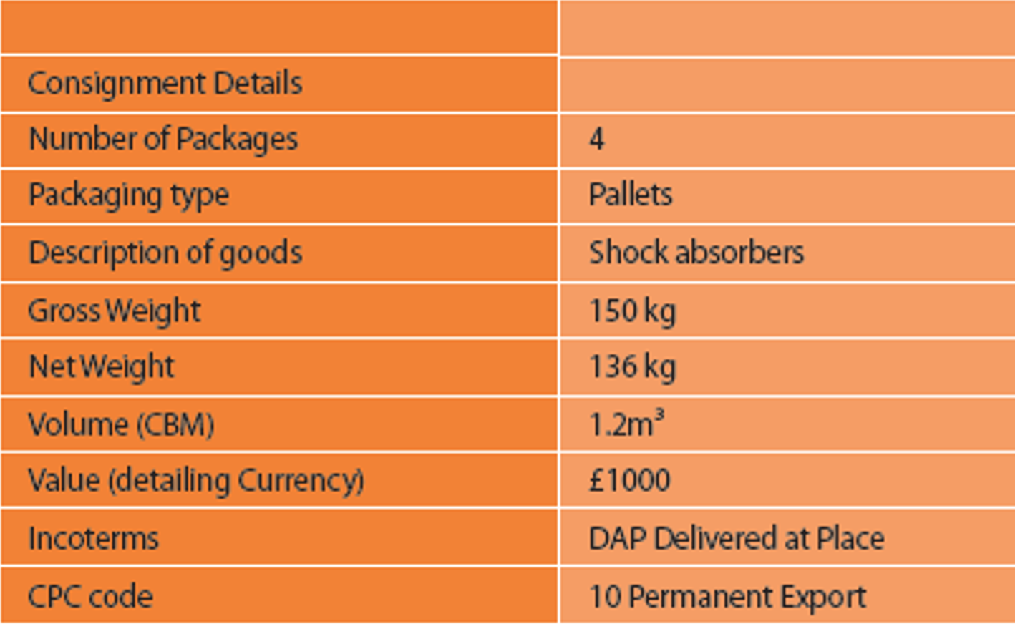
COMMERCIAL INVOICES
TO DO: Make amendments to your commercial invoices and send a copy invoice to us at brexit@espaceglobalfreight.com for verification.

Slide 8
2 different ways to make import declarations from 1.1.2021
Full (standard) and deferred declarations
https://assets.publishing.service.gov.uk/government/uploads/system/uploads/attachment_data/file/910155/How_to_import_goods_from_the_EU_into_GB_from_January_2021.pdf

Slide 9
FULL STANDARD DECLARATION
Pre-lodged UK import declaration prior to arrival
Goods arrive in the UK, an amendment message sent to CHIEF to complete the declaration triggering import VAT and duty. Declaration must be finalised by the end of the day after the goods arrival date.
Step by Step interactive guide
https://www.gov.uk/import-goods-outside-eu

Slide 10
DEFERRED DECLARATIONS
Simplified Frontier Declaration (SFD) followed by a supplementary declaration
Minimal information to make SFD, 7 fields, but supplementary declaration needed for each SFD.
More suited to high volume importers, parcel carriers
EIDR (Entry into Declarants Records) / CFSP (Customs Freight Simplified Procedures)
Allows for import declarations to be suspended for 6 months from date of entry
For Example
Goods enter UK 10th January 2021
latest import declaration 10th July 2021
Goods enter 30th June 2021
latest import declaration 30th December 2021
Goods enter 1st July 2021,
latest import declaration 4th August 2021 using CFSP authorised customs agent.

Slide 11
EIDR: 4 QUESTIONS
Who is eligible to use EIDR?
All traders as long as they have a good compliance record, including new companies. No authorisation needed, but UK EORI number is needed
Traders with poor compliance record will be written to and instructed to use full declaration option
https://www.gov.uk/government/news/government-accelerates-border-planning-for-the-end-of-the-transition-period
What format does the information need to be in?
Electronic
Can all types of goods be imported using EIDR?
No
Animal products, alcohol, tobacco, firearms, controlled goods imported at the frontier, goods under ATA carnet. Staged approach.

Slide 12
WHAT INFORMATION MUST BE RECORDED?
These are fields the importer needs to record on their EIDR:
The commodity code
The customs procedure code
Your declaration unique consignment reference - which is the main reference number that links declarations in the Customs Handling of Import and Export Freight (CHIEF) system
Purchase and, if available, the sales invoice numbers
The date and time of entry in records - creating the tax point, which is used for working out VAT payments later
Any temporary admission, Free Zone, warehousing or temporary storage stock account references
The Free Zone or warehouse approval number
A written description of the goods - so they are easy to identify
Customs value
Quantity of goods - for example, number of packages and items, net mass
Details of licensing requirements and licence numbers
Details of any supporting documents, including the serial numbers, where appropriate
The Free Zone or warehouse approval number
A written description of the goods - so they are easy to identify
Customs value
Quantity of goods - for example, number of packages and items, net mass
Details of licensing requirements and licence numbers
Details of any supporting documents, including the serial numbers, where appropriate, needed before the goods can be released https://www.gov.uk/guidance/making-an-import-declaration-in-your-records

Slide 13
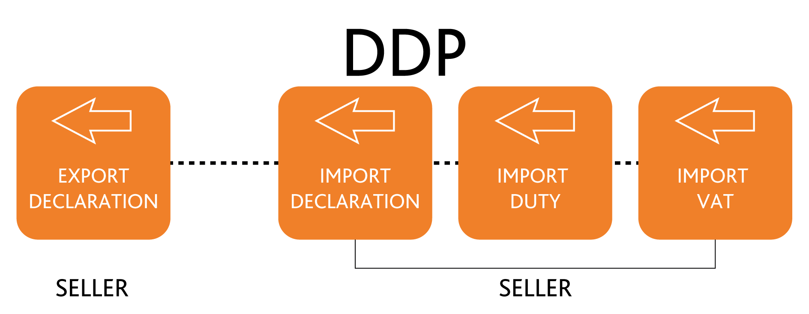
IMPORTING GOODS UNDER DDP TERMS
EU seller responsible for UK duty, customs clearance and VAT
EU seller will need UK VAT registration and UK EORI number
EU seller will need to engage a UK customs broker on an indirect basis, meaning
Broker jointly severally liable for customs debt of the non-established foreign importer
EU seller has a virtual identity in UK and charges UK importer local VAT on eventual supply

Slide 14
DAP ( Delivered at Place)
EU seller delivers to UK importer’s premises.
UK importer pays any duty, the import declaration charge and either pays VAT on PVA or on arrival.
EXW / FCA ( Free Carrier Arrival )
If the UK importer arranges the transport from their EU supplier, best to agree FCA ( Free Carrier Arrival ) INCO term. Why?
EU Supplier then responsible for export declaration from their country.
Cost 55 euros per EU export declaration.
No need to find an EU customs agent to make the declaration.

Slide 15
UK GLOBAL IMPORT TARIFF
On Tuesday 19th May the UK’s ‘Global Tariff’ was published.
These tariffs that will apply to any products that the UK imports on a Most Favoured Nation (MFN) basis from 1st January 2021 when the UK is no longer bound by the EU’s Common External Tariff.
Under the new Global Tariff, 66% of tariff lines will see some degree of change.
Tariffs on around 2000 products have been fully eliminated.
Under the WTO's "most favoured nation" rules, the UK cannot lower tariffs just for the EU (or any specific country) without doing so for the rest of the world, unless it had agreed a trade deal, or as part of a transition to that deal.
To check if your EU imports will be levied with a duty in the event of no Free Trade Agreement, enter the commodity code into the below website.
https://www.gov.uk/check-tariffs-1-january-2021

Slide 16
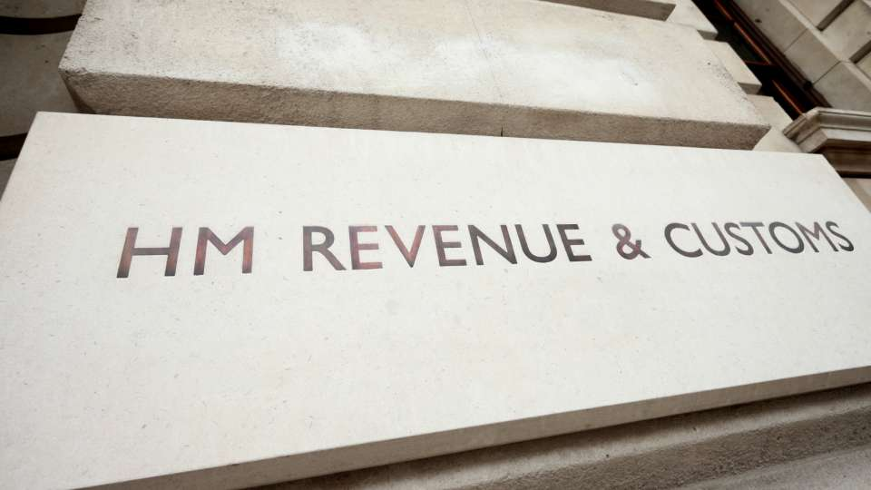
DUTY DEFERMENT ACCOUNT (DDA)
What does a DDA let you do?
A duty deferment account normally backed by a bank guarantee lets you make one payment a month through Direct Debit instead of having to pay the duty on individual consignments as they arrive in the UK.
4 benefits of having a DDA
Delay payment of duty till the 15th day of the month following the month of import.
Duty does not have to be paid immediately as goods enter the UK.
Quicker, as physical payments do not to be made prior to goods arrival.
Cheaper. Most forwarder charge a £15 admin fee plus 2% of the duty amount.

Slide 17
GOOD NEWS! £10,000 DDA NO BANK GUARANTEE
You can apply for a higher amount by submitting financial information to support your application.
To complete your application you’ll need:
Your Government Gateway login
EORI number
Company name & address associated with your EORI number
Registered company number (if this applies), in the UK
Correspondence address
VAT number (if this applies)
Directors’ and officials’ details, including date of birth
The person responsible for customs authorisations..
..their details and practical customs experience
Your estimated monthly customs duty and excise duty
https://www.gov.uk/guidance/apply-for-an-account-to-defer-duty-payments-when-you-import-or-release-goods-into-great-britain

Slide 18
POSTPONED VAT ACCOUNTING
No physical payment of VAT on arrival. VAT just needs to be accounted for.
Accounting for import VAT on your VAT return means traders can declare and recover import VAT on the same VAT Return, rather than having to pay it upfront and recover it later.
You do not need to be authorised to account for import VAT on your VAT Return.
NOTE:
TELL YOUR BROKERS YOU WANT TO USE PVA. MAKE IT CLEAR IN YOUR STANDING AND INDIVIDUAL CLEARANCE INSTRUCTIONS TO THEM.
MAKE SURE YOUR ACCOUNTS DEPT ARE AWARE AND UNDERSTAND THE IMPACT ON THE VAT PROCESS.

Slide 19
WHEN YOU CAN ACCOUNT FOR IMPORT VAT ON YOUR VAT RETURN
You can do this if:
the goods you import are for use in your business
you include your EORI number starting with ‘GB’ on your customs declaration
you include your VAT registration number on your customs declaration.
Do I need to set this up?
No. It is triggered by including your EORI and VAT number on the import customs declaration
(enter ‘G’ as the method of payment in box 47e)
VAT will be recorded against your EORI and will be at declaration level only.

Slide 20
HOW TO COMPLETE YOUR VAT RETURN
An online monthly statement will be available to download and keep for your records. It will show the total import VAT postponed for the previous month which you should include in your VAT Return.
Due to postponed VAT accounting, there will be changes to the way you complete the boxes on your VAT Return.
Box 1 Include the VAT due in this period on imports accounted for through postponed VAT accounting.
Box 4 Include the VAT reclaimed in this period on imports accounted for through postponed VAT accounting.
Box 7 Include the total value of all imports of goods included on your online monthly statement, excluding any VAT.
If you delay your customs declaration
If you import goods that are not controlled into Great Britain from the EU between 1 January and 30 June 2021 and delay your customs declaration you must account for import VAT on the VAT Return which includes the date you imported the goods.
To complete the boxes on your VAT Return, you’ll need to estimate the import VAT due from your records of imported goods.
When you submit your delayed declaration, your next online monthly statement will show the amount of import VAT due on that declaration. You’ll then be able to:
adjust your estimate
account for any difference on your next VAT Return

Slide 21
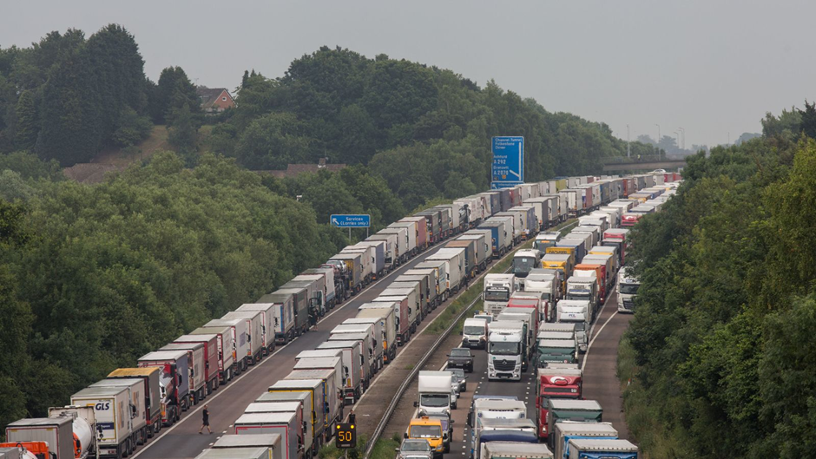
ALTERNATIVE MEANS OF TRANSPORT TO IMPORT GOODS INTO UK FOR EU

Slide 22
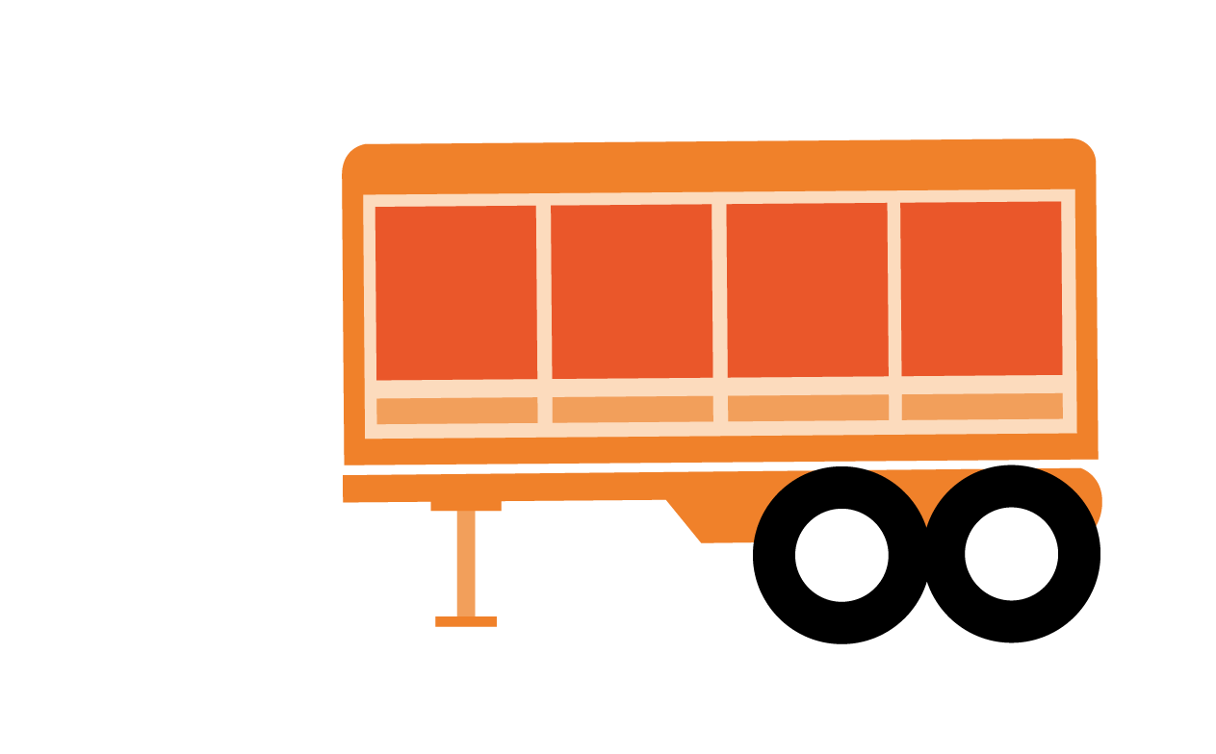
HOW TO AVOID CALAIS / DOVER CONGESTION?
https://www.espaceglobalfreight.com/european-intermodal-transport-advantages-disadvantages/
1. Intermodal transport
2. Un-accompanied trailers
Tilbury, Hull, Immingham, Felixstowe, Harwich, Teesport, Newhaven, Rosyth ( Edinburgh), Plymouth, Poole, Portsmouth
https://www.espaceglobalfreight.com/unaccompanied-trailers-driver-accompanied-freight

Slide 23
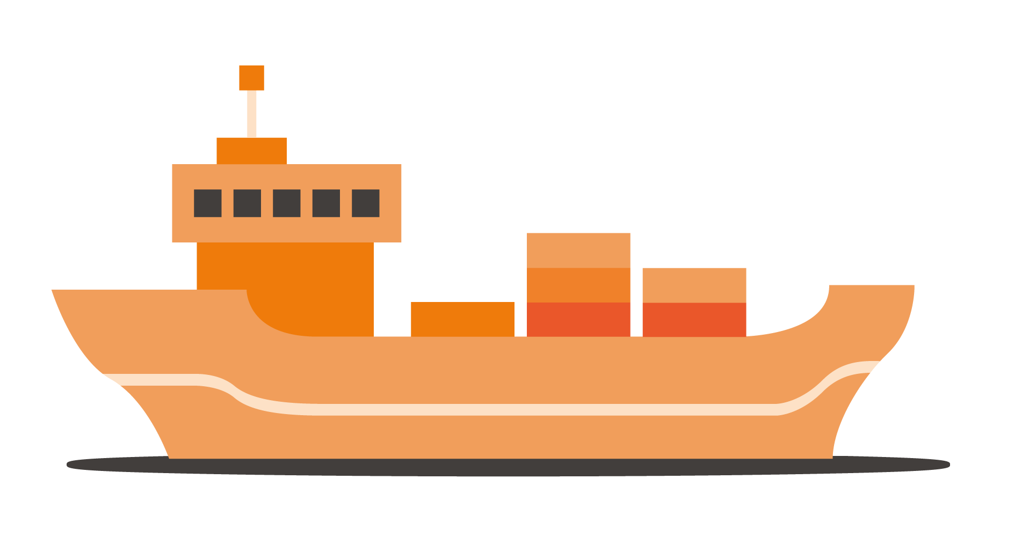
3. European short-sea shipping
40 ft containers , 12.2m x 2.35m x 2.39m , 24 CHEP / 30 europallets

Slide 24
DIRECT REPRESENTATIVE AUTHORISATION FORM
https://www.espaceglobalfreight.com/brexit-import-export-guidance/

Slide 25
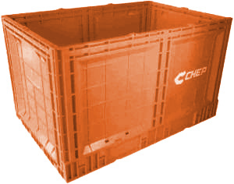
RETURN PACKAGING TO EU
“Under the current EU rules pallets arriving from non-EU origins that will be re-exported are controlled as temporary imports and are duty free. There is an onus on the UK importer to control them and know their whereabouts and there are mechanisms to allow a “pool” of equipment to be used.”
Trackers have to be in place for returnable packaging at both ends which need to be auditable by HMRC - the packaging needs to be identifiable - i.e. have individual numbering.
https://www.gov.uk/guidance/pay-less-import-duty-and-vat-when-re-importing-goods-to-the-uk-and-eu

Slide 26
COMMERCIAL SAMPLES
Preparation is important
Method A
Tearing, altering, perforating, slashing or defacing the items.
Method B
Label your goods with the term ‘commercial sample’ using a permanent indelible pen.
Method C
Limit the amount of items within the consignment and for items like garments and footwear, also limit the range of available sizes or dimensions for those items.
Method D
Present the goods in a way that restricts their handling and limits their use to that of proper commercial samples.
Commercial samples imported as freight
1. EU exporter needs to prepare goods to be used as samples.
2. On the import declaration get your customs broker to enter the following Customs Procedure Codes (CPC) in box 37.
CPC 40 00 C30 – for goods imported from outside the UK on which you claim relief from import duty and VAT
NB: There are certain goods that cannot be classed as a sample. See guidance link above.
https://www.gov.uk/guidance/pay-no-import-duty-and-vat-on-importing-commercial-samples

Slide 27
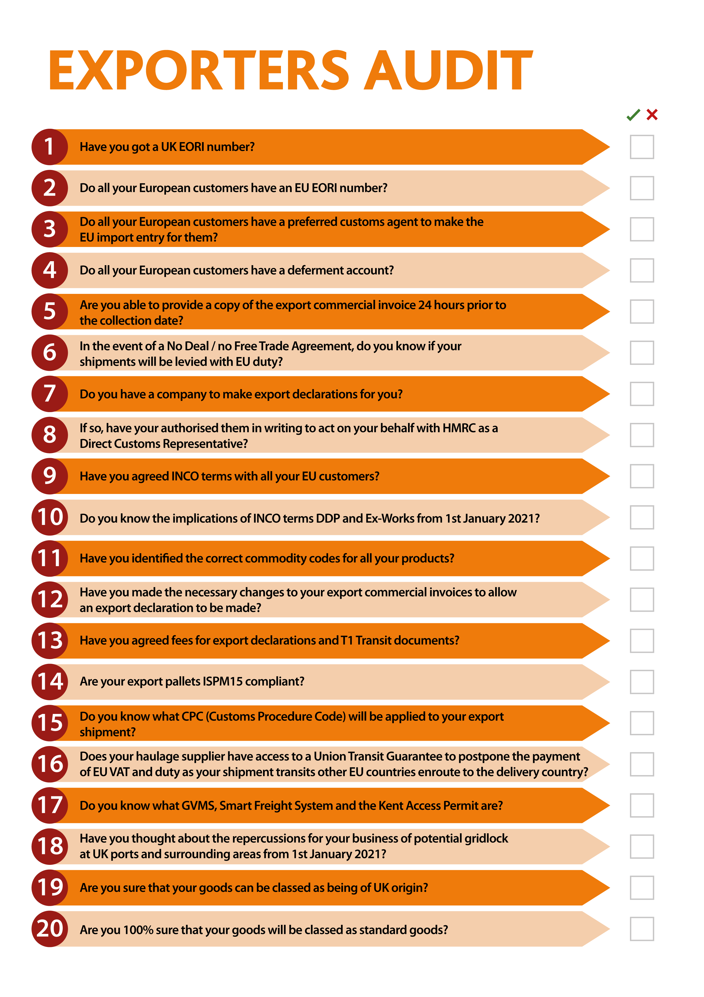
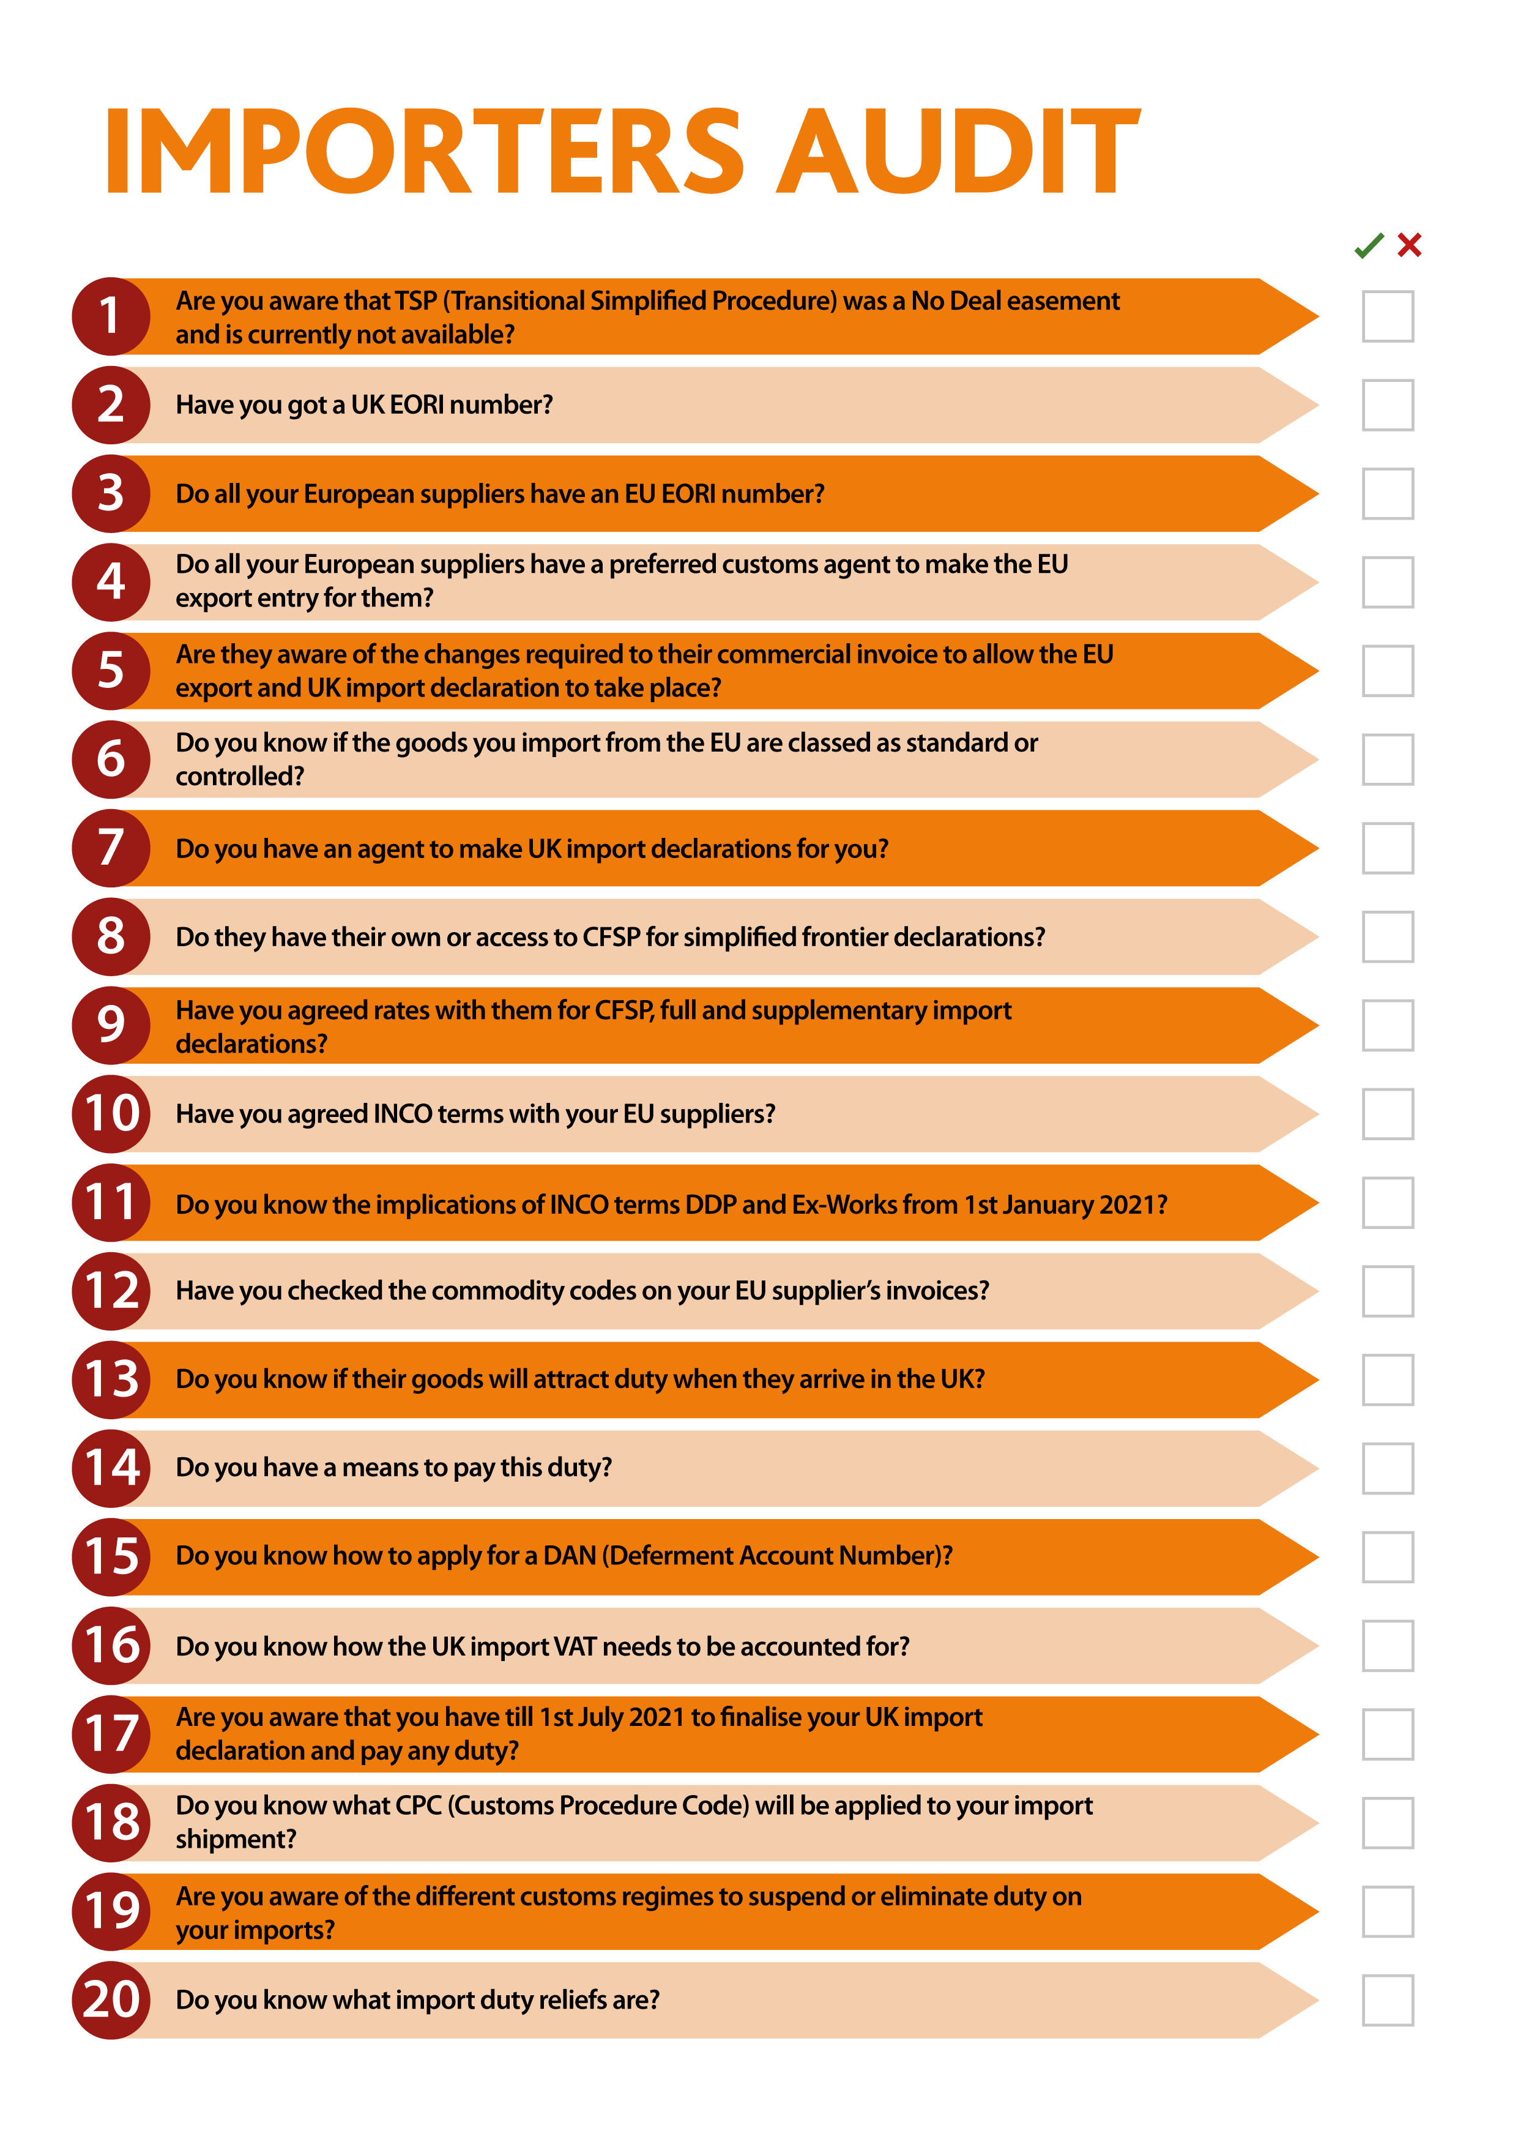

Slide 28
SPECIAL BONUS
EMAIL: brexit@espaceglobalfreight.com

Slide 29
Lack of data stops collections being organised.
Lack of data stops trailers being loaded.
Lack of data stops drivers departing.
Lack of data stops drivers at customs offices.
Lack of data stops drivers getting on ferries.
Lack of data stops deliveries being made.
Lack of data STOPS EVERYTHING.

Slide 30
Brexit customs solutions for £1 a day
https://www.customsclearanceeurope.com/benefits/
Next Zoom meeting will be on Wednesday 9th December 10am
Short 10-15 minute presentation
Recent developments / HMRC updates
Key point for exporters and importers
Key information not previously covered
Then a Q&A.

Slide 31
www.customsclearanceeurope.com
brexit@espaceglobalfreight.com
£99 : 1 hour introductory offer
rob@clearlightcustoms.com

