Slide 2
ON THE WEBINAR TODAY
Tony Shally
MD and Head of all things Brexit
Robert Pryce
Clearlight Customs Ltd
Geoff Yates
Commercial Manager

Slide 3
CONTENTS
Key updates for Exporters
Key updates for Importers
Ten critical Brexit planning points
Q&A

Slide 4
KEY UPDATES FOR EXPORTERS
2 types of Full load exports
Enter the EU at a port in the country where the delivery will take place e.g Rotterdam port for Amsterdam delivery.
Enter the EU at a port in a country that is different to the country of delivery e.g Calais port for delivery to Milan, Italy.
Why is this important?

Slide 5
SMART FREIGHT (CHECK A HGV IS READY TO CROSS THE BORDER)
7.5 tonner and above
https://check-an-hgv-is-ready-to-cross-the-border-demo.fbplatform.co.uk

Slide 6
Issue : Ready for 1st January?

Slide 7
A HGV DRIVER CARRYING AN EXPORT FULL LOAD MUST HAVE ONE OF THESE TWO DOCUMENTS TO EXIT THE UK
Pre-lodged EU import declaration
Enter the EU at a port in the country where the delivery will take place.
Transit Accompanying Document (TAD)
Enter the EU at a port in a country that is different to the country of delivery.
PROBLEM: If the commercial invoice / data can only be generated after the goods have been loaded

Slide 8
Trade isn’t about goods Trade is about DATA Goods sit in the warehouse until DATA moves them.

Slide 9
Pre-lodged import declaration
Full load export to Amsterdam, shipping Felixstowe to Rotterdam.
Driver needs the pre-lodged Dutch import declaration in his possession before he leaves the UK loading site.
If commercial invoice only available after loading, it will take a few hours to get the pre-lodged Dutch import declaration done, possibly only the next day.
Ideally need commercial invoice for pre-lodged EU declaration and UK export declaration 48 hours before collection date
Transit
Full load export to Italy shipping into Calais
Driver needs a physical copy of the TAD. To either be given to him at the loading point if they have Authorised Consignor status or collected from a Govt customs office / Authorised site to start transit.
Vehicle arrives 2pm. Loading finished at 5pm. Commercial invoice may only be available the next day
Ideally need commercial invoice for export and transit declaration 24 hours before collection date

Slide 10
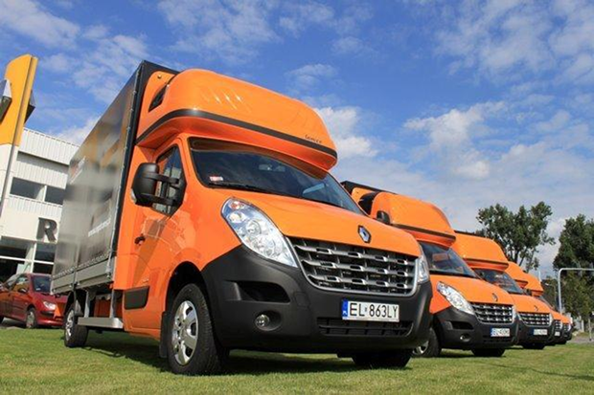
EXPORT EUROPEAN EXPRESS FREIGHT
Last minute notification
Commercial invoices likely to only be available on day of collection only
If vans load late, no-one at premises to issue commercial invoice so export and transit declarations can be made
If delivery in France, impossible to get a pre-lodged French import declaration to the driver

Slide 11
A POSSIBLE WORK AROUND FOR PRE-LODGED IMPORT DECLARATION LOADS
Main issue : Relying on 2 EU organisations to take action
Once the EU customer has the UK commercial invoice, they need to get a pre-lodged EU import declaration done by their chosen customs agent and send that back to the UK exporter to give to the collecting driver.
Solution : Use Transit
Transit will allow you to clear the goods inland in the EU thus relieving the need for a pre-lodged EU import declaration. It comes with a cost. No reliance on EU companies to action anything for the driver to exit the UK. TAD number will need to be sent to the EU importer to be quoted on the EU import declaration.

Slide 12
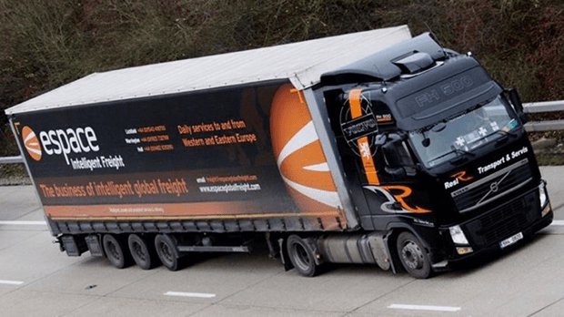
Export Groupage and part loads not affected by pre-lodged declaration and Transit issue.
Goods will remain in UK warehouse until commercial invoices are made available.
TRADE IS NOT ABOUT GOODS. IT IS ABOUT DATA. DATA MOVES GOODS.
Issue is just for export full loads and express as the driver leaves directly for the port after loading.
Driver should not be sent to load shipment unless the shipment has been given permission to proceed (P2P) from CHIEF.

Slide 13
WHAT IS THE ELEPHANT IN THE ROOM?

Slide 14
Entry Summary Declaration / Safety and Security Declaration / ENS
This is declaration that needs to be filed electronically into the Import Control System of the EU country of arrival so their Customs know what goods are arriving into their ports from 3rd countries.
Why is this important?
HGV driver cannot exit UK unless this declaration has been made.
Who is responsible for making the safety and security declaration?
Operator of the active means of transport. Ferry company for un-accompanied trailers and haulier for accompanied trailers.
When does the ENS have to be made by?
Eurotunnel 1 hour, ferry 2 hours before arrival in EU.
What is the problem?
Hauliers either don’t want to make this declaration or don’t know how to.

Slide 15
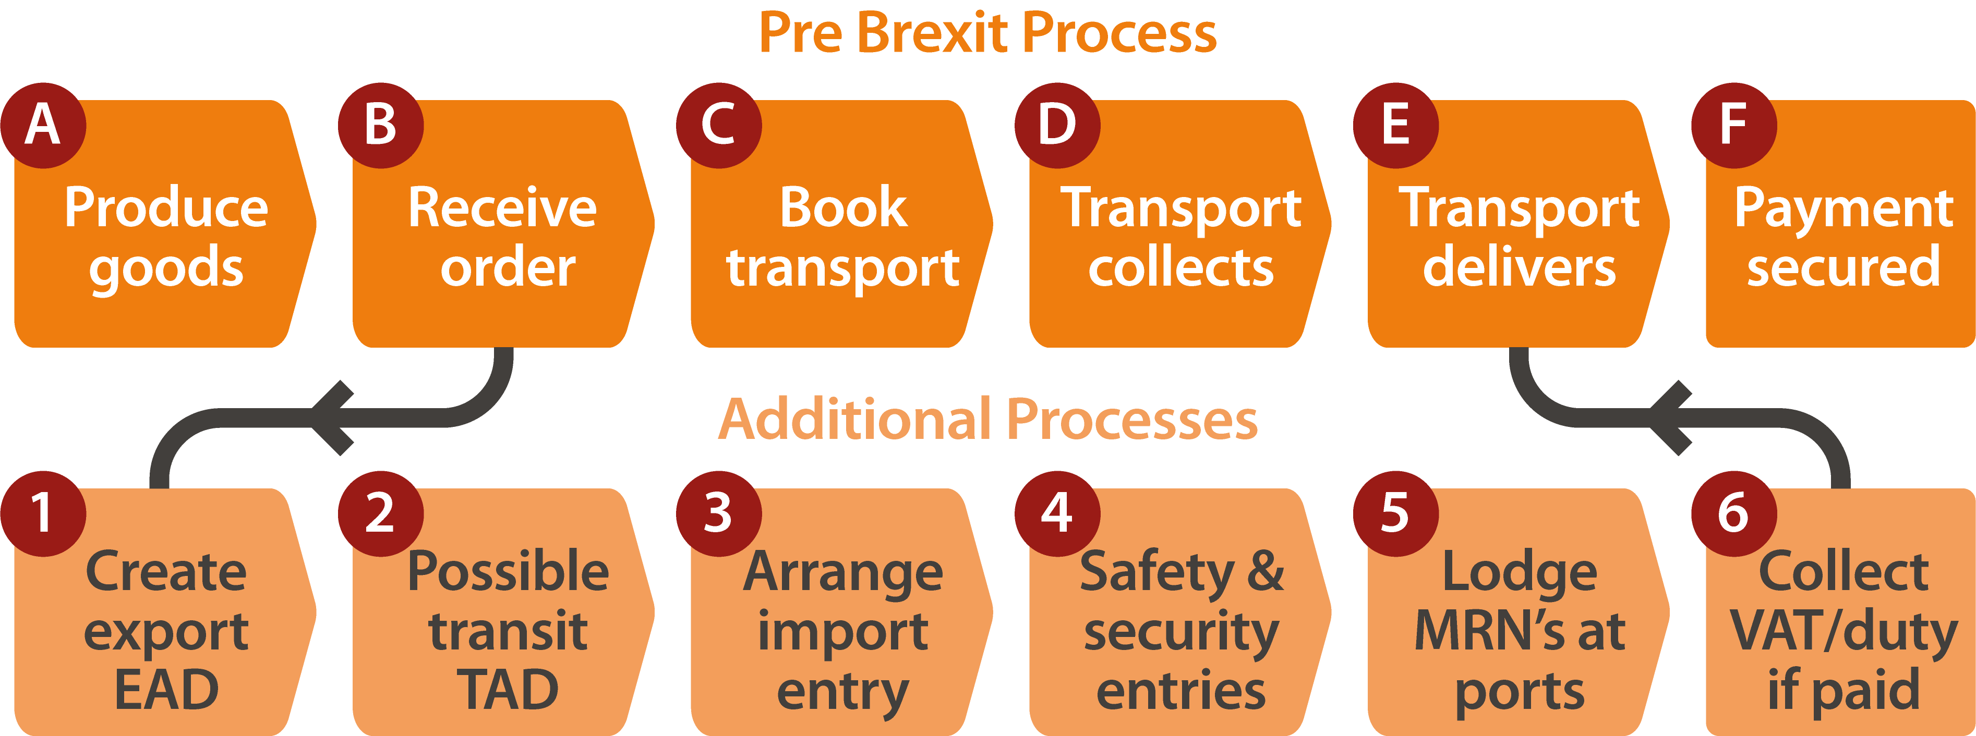
Export process pre and post Brexit
PRE-1st January 2021: Haulier does D and E
POST-1st January 2021: Someone needs to do points 1 – 6
DIFFERENCE BETWEEN A HAULIER AND A FORWARDER?
A haulier collects and delivers freight
A forwarder manages the data and the borders
Trade isn’t about goods Trade is about DATA Goods sit in the warehouse until DATA moves them.

Slide 16
KEY POINTS FOR IMPORTERS
Have to decide how you will be making your UK import declarations
Deferred (EIDR) or full declarations
Have to decide how you want to handle UK import VAT
Defer it with Postponed VAT Accounting or pay on entry
£10,000 UK deferment account without a bank guarantee
https://www.gov.uk/guidance/apply-for-an-account-to-defer-duty-payments- when-you-import-or-release-goods-into-great-britain
Will the EU supplier be able to provide a commercial invoice 24 hours prior to the loading date, get the EU export declaration done and give it to the collecting driver.

Slide 17
Ten critical Brexit planning points for Exporters and Importers
Make sure your commercial invoices and those of your EU suppliers have all the relevant information.
Agree INCO terms with EU suppliers and customers. Avoid Ex-Works and DDP.
Double check you and your EU suppliers are using the correct commodity codes. 8 digits for export, 10 for import.
Make sure you and your EU suppliers understand the different CPC codes and when to use them.
Check what duty might be applied to your exports to the EU and imports from the EU if a Free Trade Agreement is not reached.
Make sure your hauliers / logistics companies can not only move your freight but manage the borders it will cross.
Appoint a customs agent(s) to handle your customs declarations and authorise them to do so in writing.
Can you get the commercial invoice / data to your customs broker 24/48 hours prior to the loading date?
Have you spoken to your logistics companies about alternative modes of transport?
Have you and your EU customers got sufficient stock for the first 2 weeks of January?

Slide 18
YOU CAN ONLY CONTROL WHAT YOU CAN CONTROL EDUCATION IS KEY
https://www.espaceglobalfreight.com/brexit-import-export-guidance/
EMAIL: brexit@espaceglobalfreight.com

Slide 19
www.customsclearanceeurope.com
brexit@espaceglobalfreight.com
£99 : 1 hour introductory offer
rob@clearlightcustoms.com

Slide 20
Q&A

